Slide 1


Does Defense Win Championships? Can Exploring Statistical Data from the NBA give insights?
Daniel Angel
June 5, 2021
DSC 530 : Exploratory Data Analysis
Professor Shankar Parajulee

Slide 2

Data Acquisition
This Photo by Unknown Author is licensed under CC BY-SA-NC
In order to do the tasks of EDA I first need to get my data set. The data I got was from a GitHub repository of NBA data used to write an article for the Los Angeles Times. The repository also contains a description of how the data was acquired.
Data Set Directory ( Game logs from 1985-86 through 2018-19 seasons were used by me):
https://github.com/ryanvmenezes/lawlers-law/tree/master/data/logs
Data Acquisition Method Description:
https://github.com/ryanvmenezes/lawlers-law/tree/master/data

Slide 3


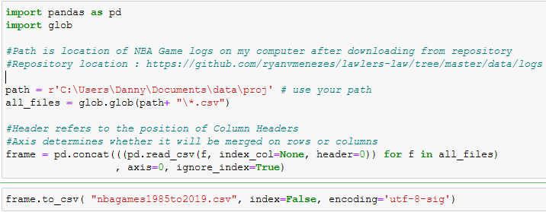
Data Merging
Next, I had to merge the files which I did using a Python script. The code is below:
This Photo by Unknown Author is licensed under CC BY-SA

Slide 4

Data Cleaning
Then cleaned the data:
Removed one outlier game where no stats were recorded
Dropped nine variables which were either redundant, useless, or irrelevant
Fixed one record which had incorrect minutes
Normalized data which came from overtime games
Created 4 new variables
Changed Win/Loss data to a binary variable
Replaced Nan’s with zeros
This Photo by Unknown Author is licensed under CC BY-SA-NC

Slide 5
Hypothesis Formulation
The original question “Does defense win championships?” is impossible to answer with the data set which contains only game stats for regular season games. It’s possible to obtain data about who won championships but I couldn’t think how to get this without manual entry.
Also, how a team plays in the regular season could be different from how they play in the playoffs.
Instead, I reformulated my question as:
Does defense win games? or, Are defensive statistics a good predictor of a game’s victor?

Slide 6
Variable Descriptions The variables used are all classic defensive basketball statistics.
‘DREB’ – abbreviation of defensive rebounds. The number of defensive rebounds collected by the team. A rebound is getting the ball after a miss. A defensive rebound is a rebound when the other team is shooting. [integer]
‘BLK’ – abbreviation of blocks. The number of blocks collected by the team. A block is a defender preventing an opponent’s shot. [integer]
‘STL’ – abbreviation of steals. The number of steals collected by the team. A steal is a “takeaway” from an offensive player. [integer]
‘OPP_PTS’ – abbreviation of opponents’ points. The number of points scored by the other team. This variable was created through a transform by me. (Points(PTS) minus Plus/Minus (PLUS_MINUS) [integer]

Slide 7
Variable Descriptions(continued) The variables used are all classic defensive basketball statistics.
‘REB_RATE’ – abbrev. of Rebounding Rate. Variable created through a transformation. Rebounding rate is the percentage of rebounds collected out of all available potential rebounding situations. The calculation is ‘DREB’ divided by quantity of ‘DREB’ plus opponents’ ‘OREB’ (offense rebs). [float]
‘OPP_FG_PCT’ – abbreviation of opponents’ field goal percentage. Percentage of shots made by other team. Not entirely determined by defense but defense is a factor. [float]
‘OPP_3FG_PCT’ – abbreviation of opponents’ 3 point field goal percentage. Percentage of three pointers made by other team. Not entirely determined by defense but defense is a factor. [float]

Slide 8
Variable Descriptions(continued) The variables used are all classic defensive basketball statistics.
All the variables previously described are independent variables. The variables on this slide are our dependent variables.
‘PLUS_MINUS’ – Plus/Minus is a measure of the margin of victory/loss. It is calculated by subtracting the other team’s score from the original team’s score. Positive indicates victory whereas negative indicates a loss. [integer]
‘WL’ – abbreviation of Win/Loss. Did this team Win or Lose? This variable is one of our key variables that we can use to GroupBy on. W indicates Win, L indicates Loss. Easily converted to a binary variable. [categorical]

Slide 9
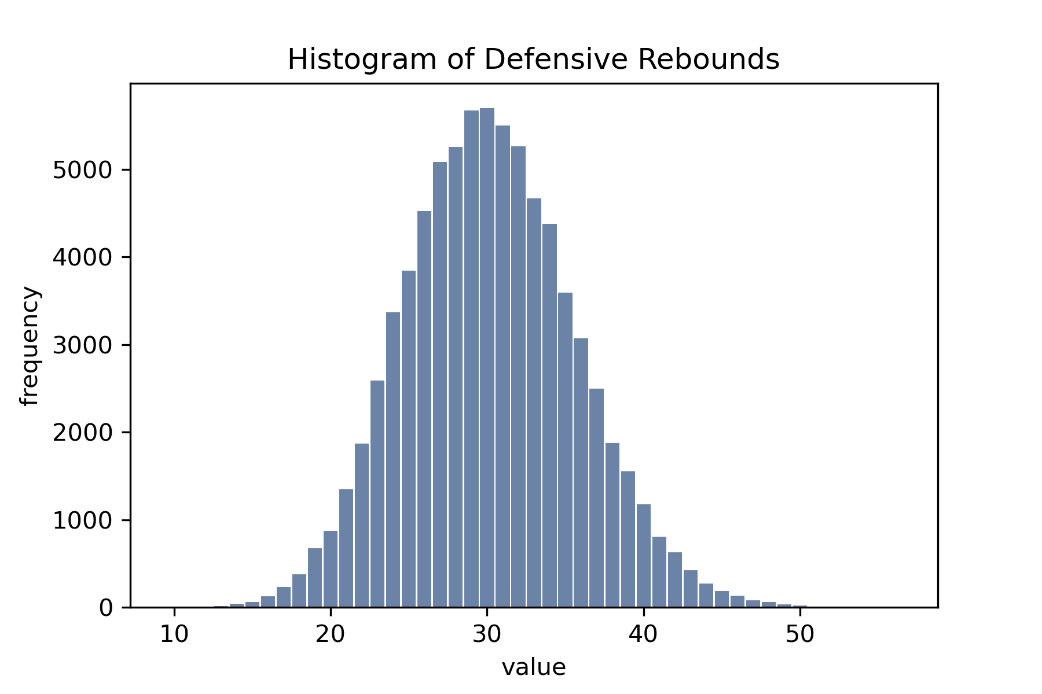
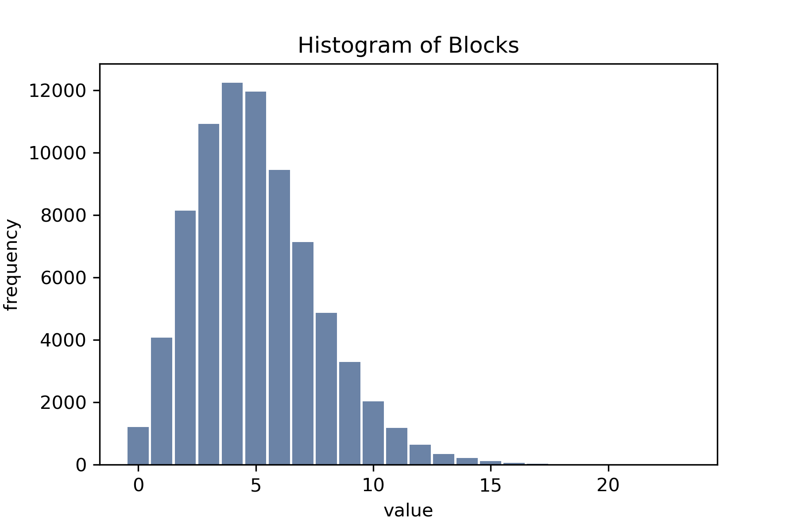
Histograms
For rebounds, anything less than 15 or more than 46 should be considered an outlier.
For blocks, zeros or games having over 12 should be considered outliers.
Fairly normal distribution. Not heavily skewed. Positive kurtosis (leptokurtic)
Positively skewed (right skewed) the right tail is significantly heavier.

Slide 10
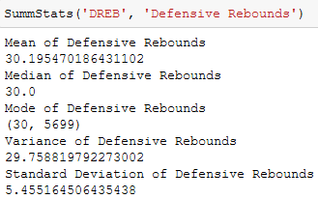
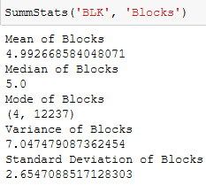
Summary statistics for rebounds and blocks
Mode of blocks is less than median as we would typically expect from a positively skewed distribution
Mean, median and mode of defensive rebounds all virtually the same which is what we would expect
from a normal distribution. Also, the standard deviation also meshes well with
what was visually observed regarding outliers.

Slide 11
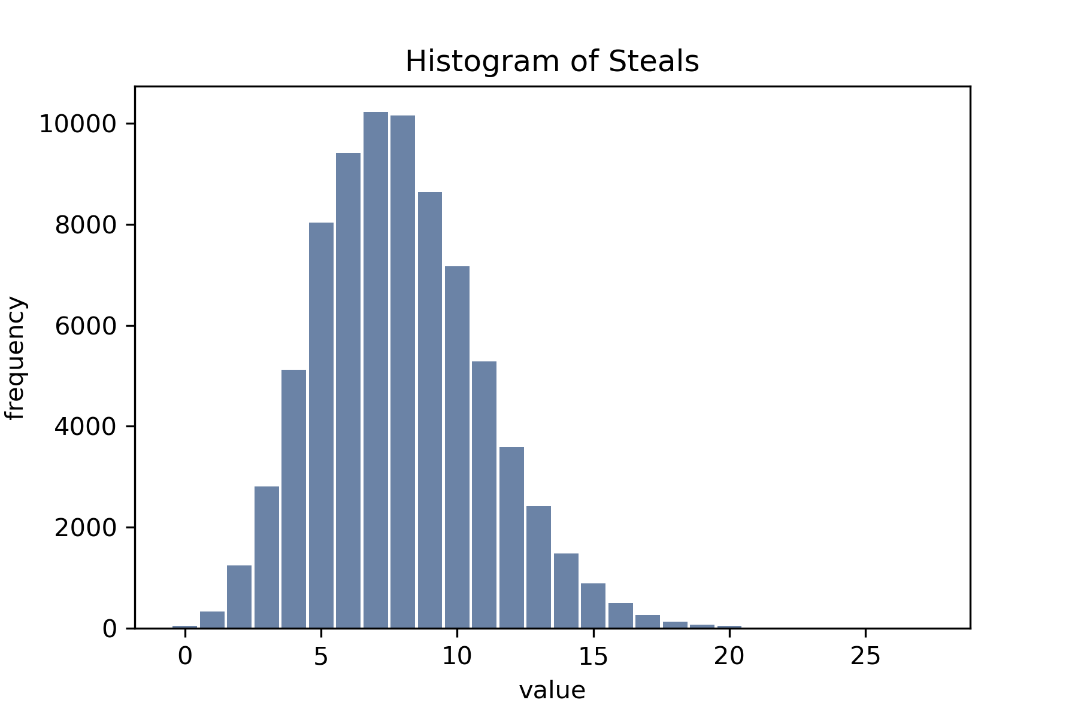
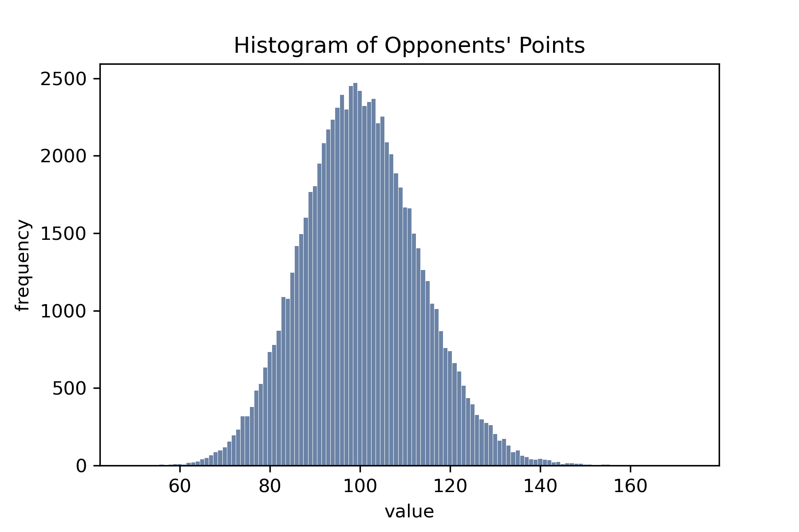
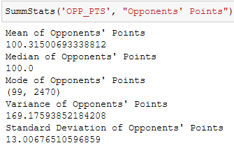
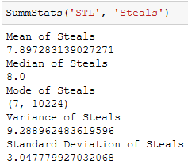
Histograms(continued)
A game where a team scores less than 66 points or more than 136 should be considered an outlier.
Games where a team collects 2 or less
total steals or more than 15 are outliers.
Positively skewed (right skewed) the right tail is significantly heavier.
Fairly normal distribution. Not heavily skewed. Positive kurtosis (leptokurtic)

Slide 12
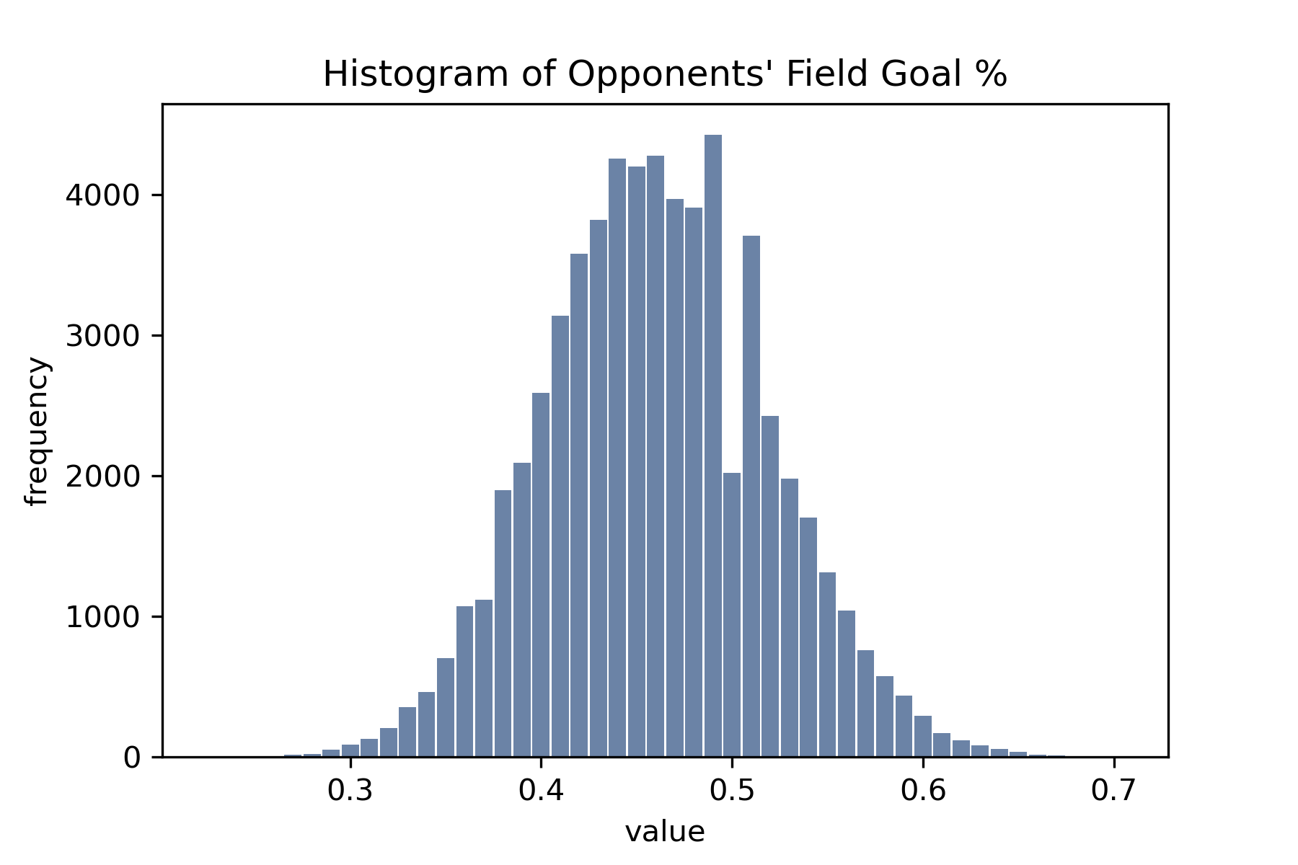

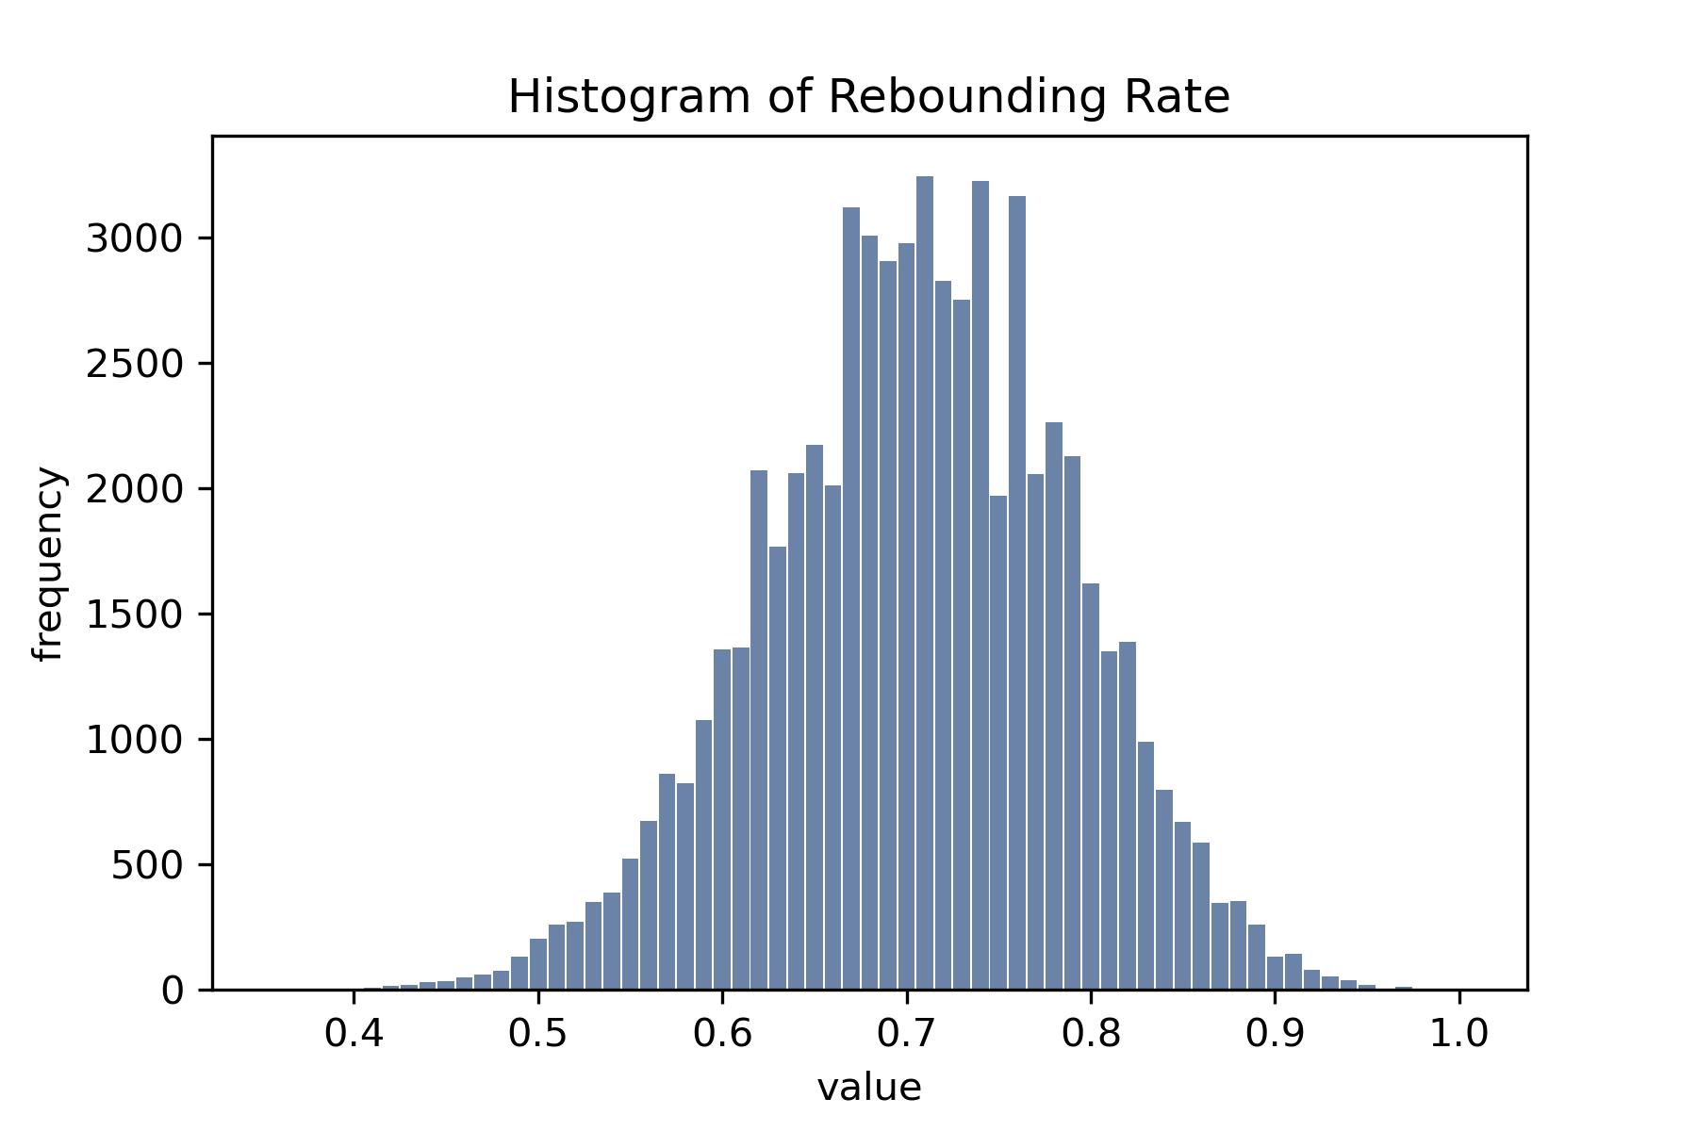
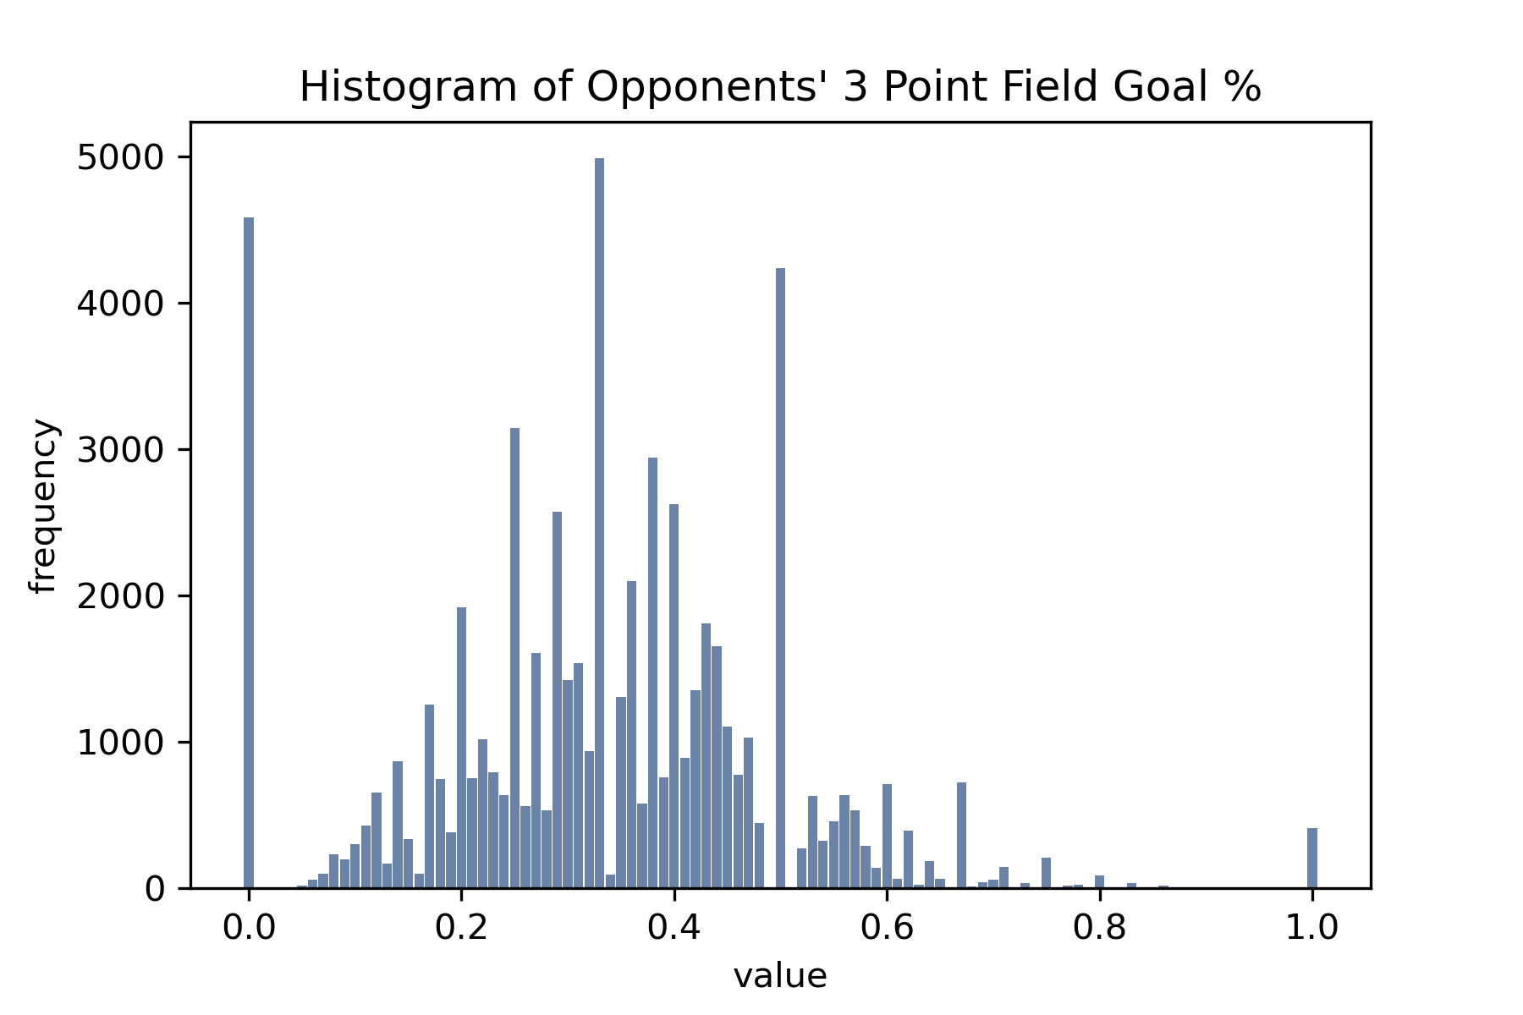
The dip at 50% is surprising and indicates teams are as likely to make exactly half their shots than they are to make 53% or 39%. This could be due to field goal attempts being normally distributed and so 50% is only even possible half the time when an odd number of shots are taken.
The left tail is heavier and indicates a
team is more likely to shoot poorer than
average than higher than average,
Rebounding rate shows a slightly negatively skewed and slightly leptokurtic(positive) kurtosis.
Outliers look like rates higher than 90% and less than 50%
The spiky nature of this
Histogram is an artifact
of the rounding I performed, how the %
is calculated and that
less three pointers are
attempted than other field goals.

Slide 13
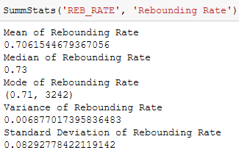
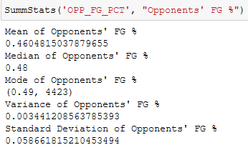
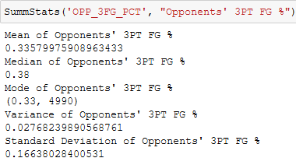
Summary Stats of FG %, 3pt FG%, and Rebounding Rate

Slide 14
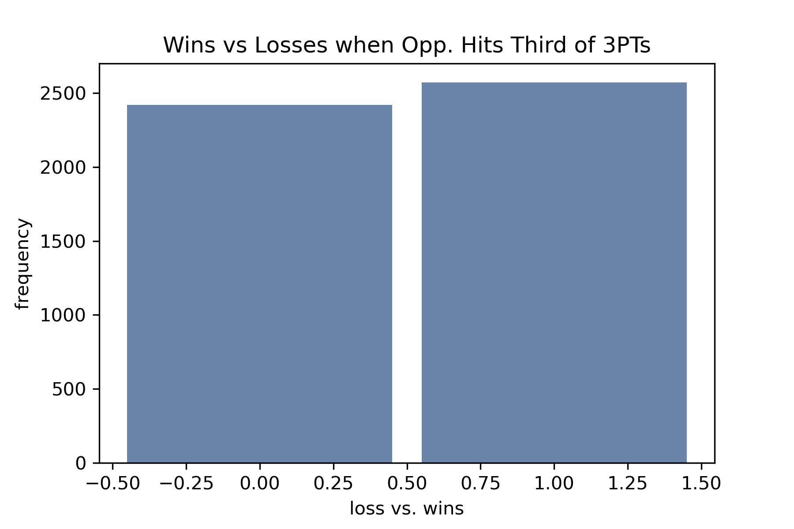
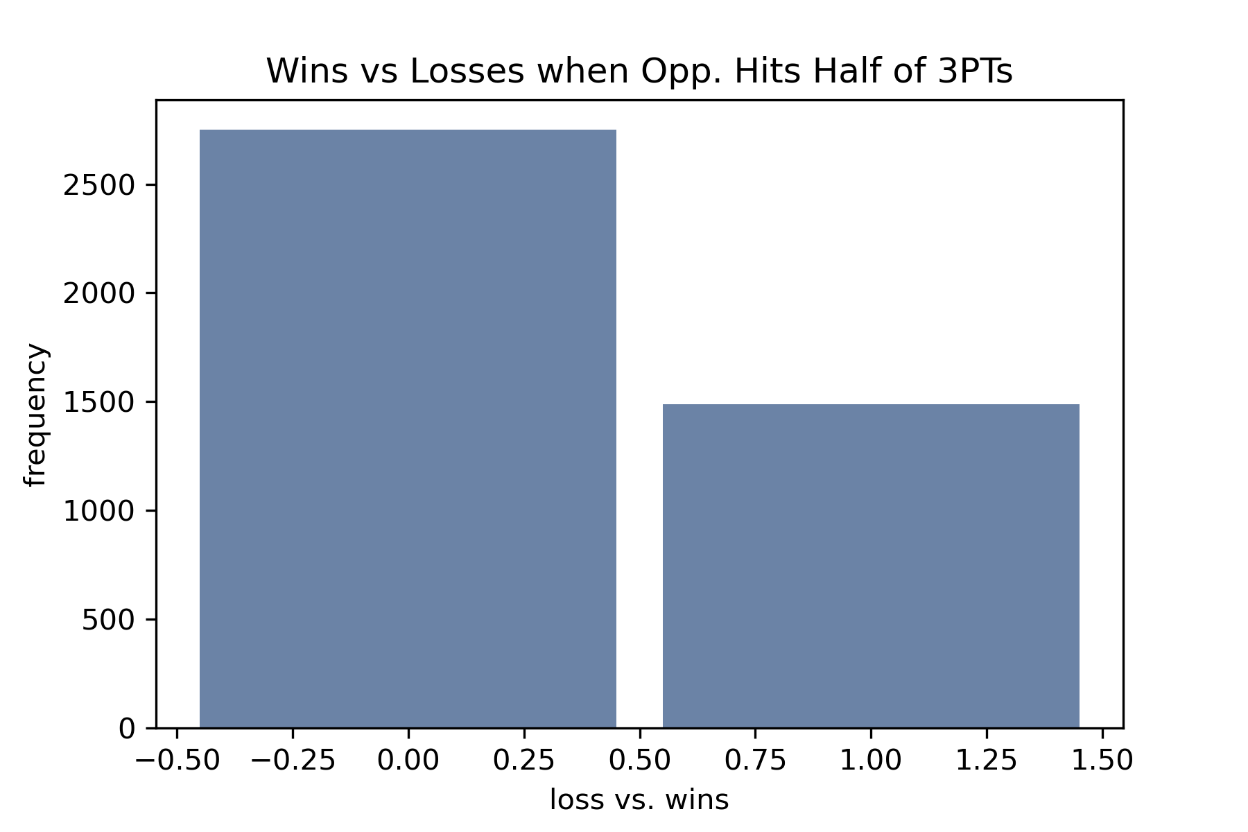
Should defense against three pointers be a priority for defenses?
Although these histograms are not really demonstrating their intended
purpose they still reveal interesting facts. The bottom histogram shows that
a team is half as likely to win than to lose if they allow the opposing team to
make half of their three-point attempts.
The top histogram shows that if an opponent is held to 33% shooting your
team is slightly more likely to win.

Slide 15
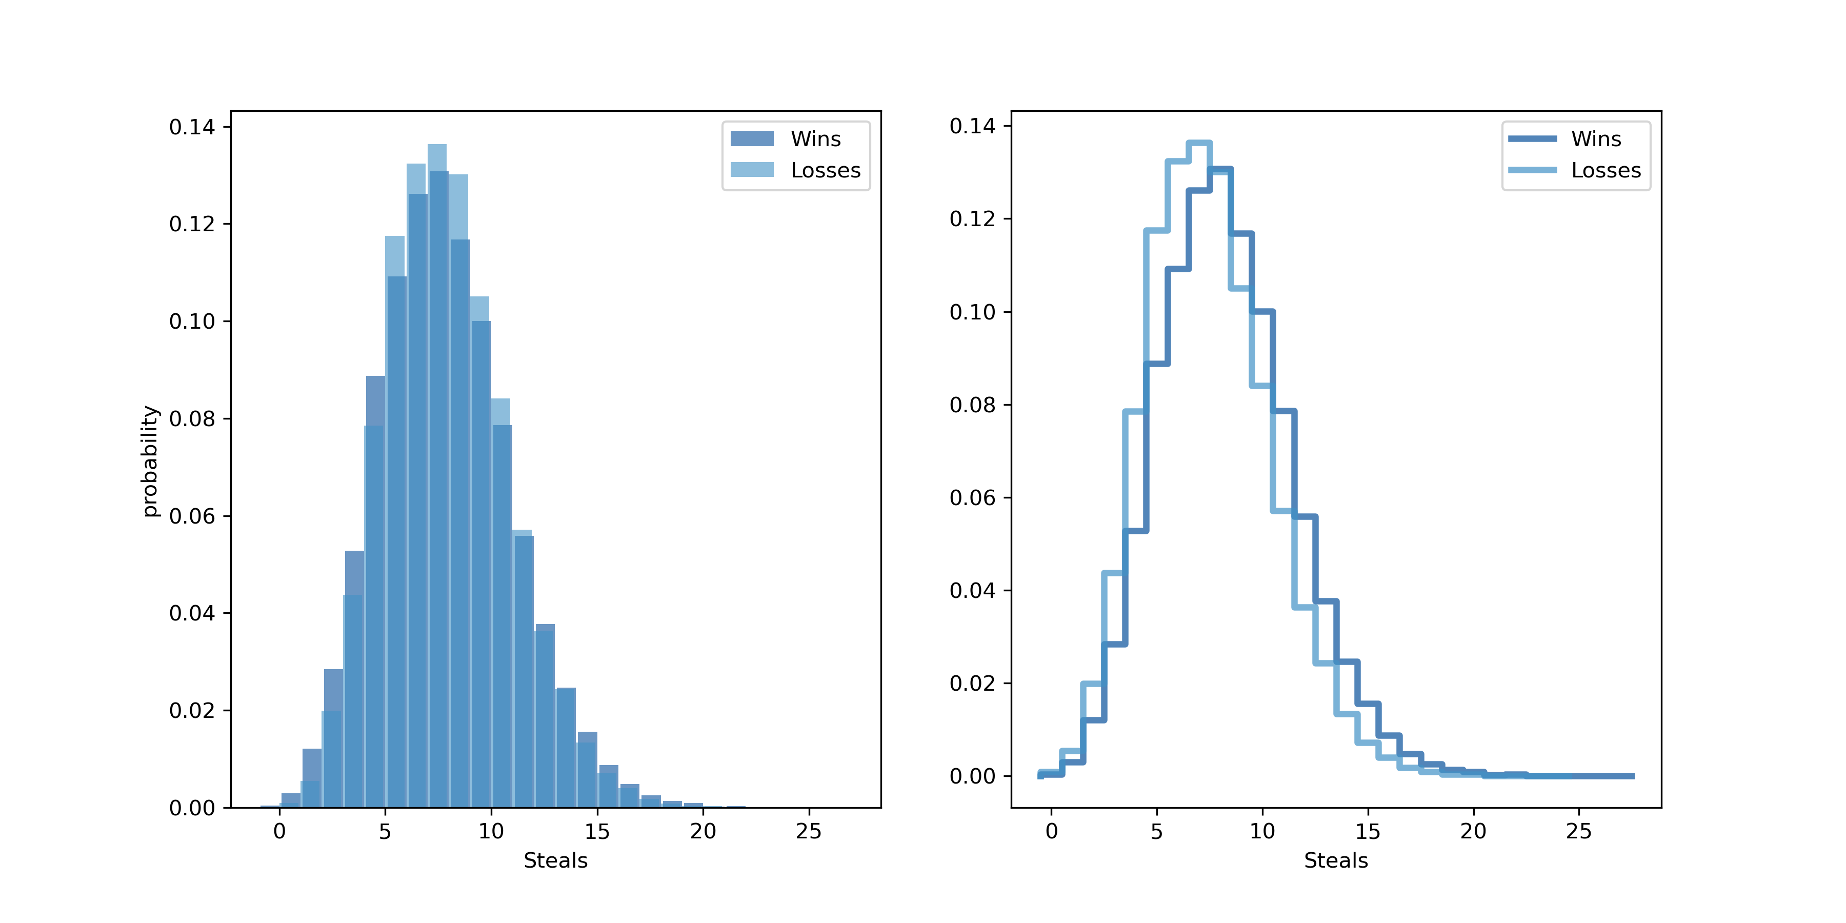
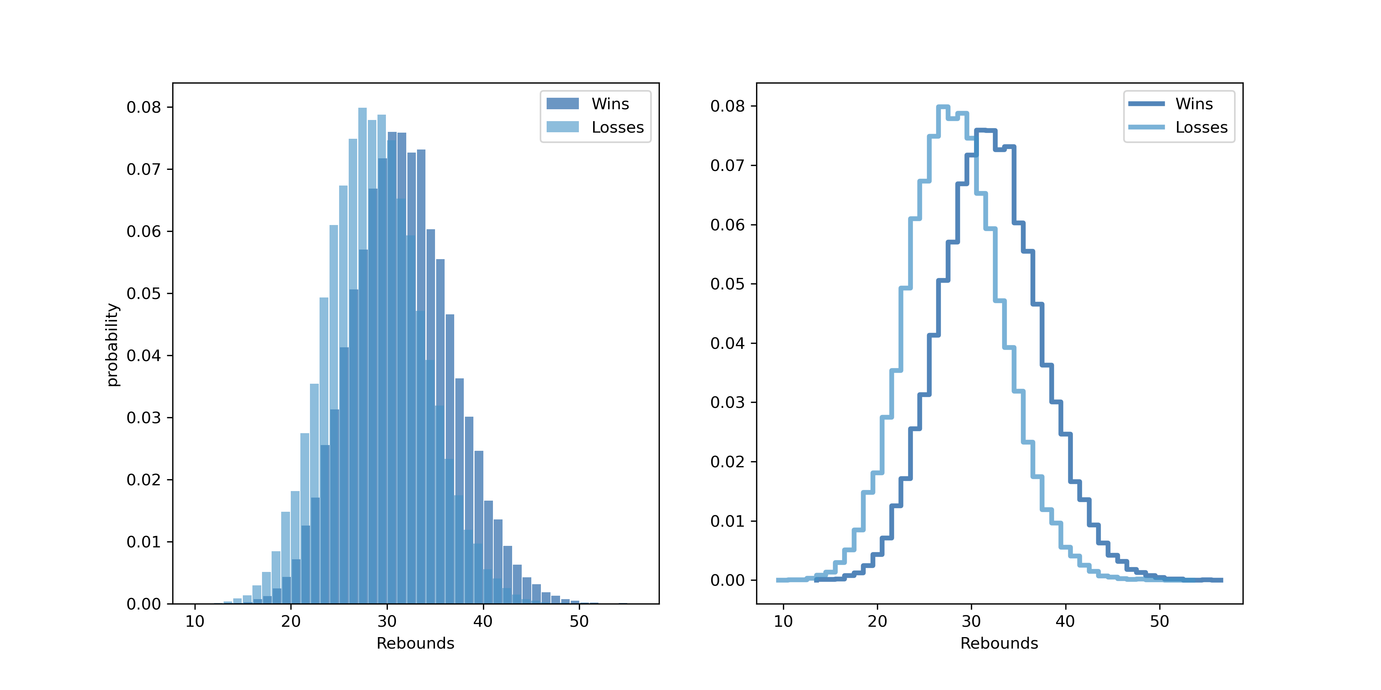
PMF’s of Win vs. Loss Scenarios rebounds and Steals
I plotted both the bar charts and the step functions since they both have interesting properties. The bar chart makes overlaps easier to see while the step function makes the crossovers and the differences more obvious.
The point on the x-axis where the plots intersect corresponds with the number of steals or blocks at which there is an equal probability of winning or losing. Above that number you are increasing your chances of winning; below that amount and it is more likely that your team will experience a loss.

Slide 16
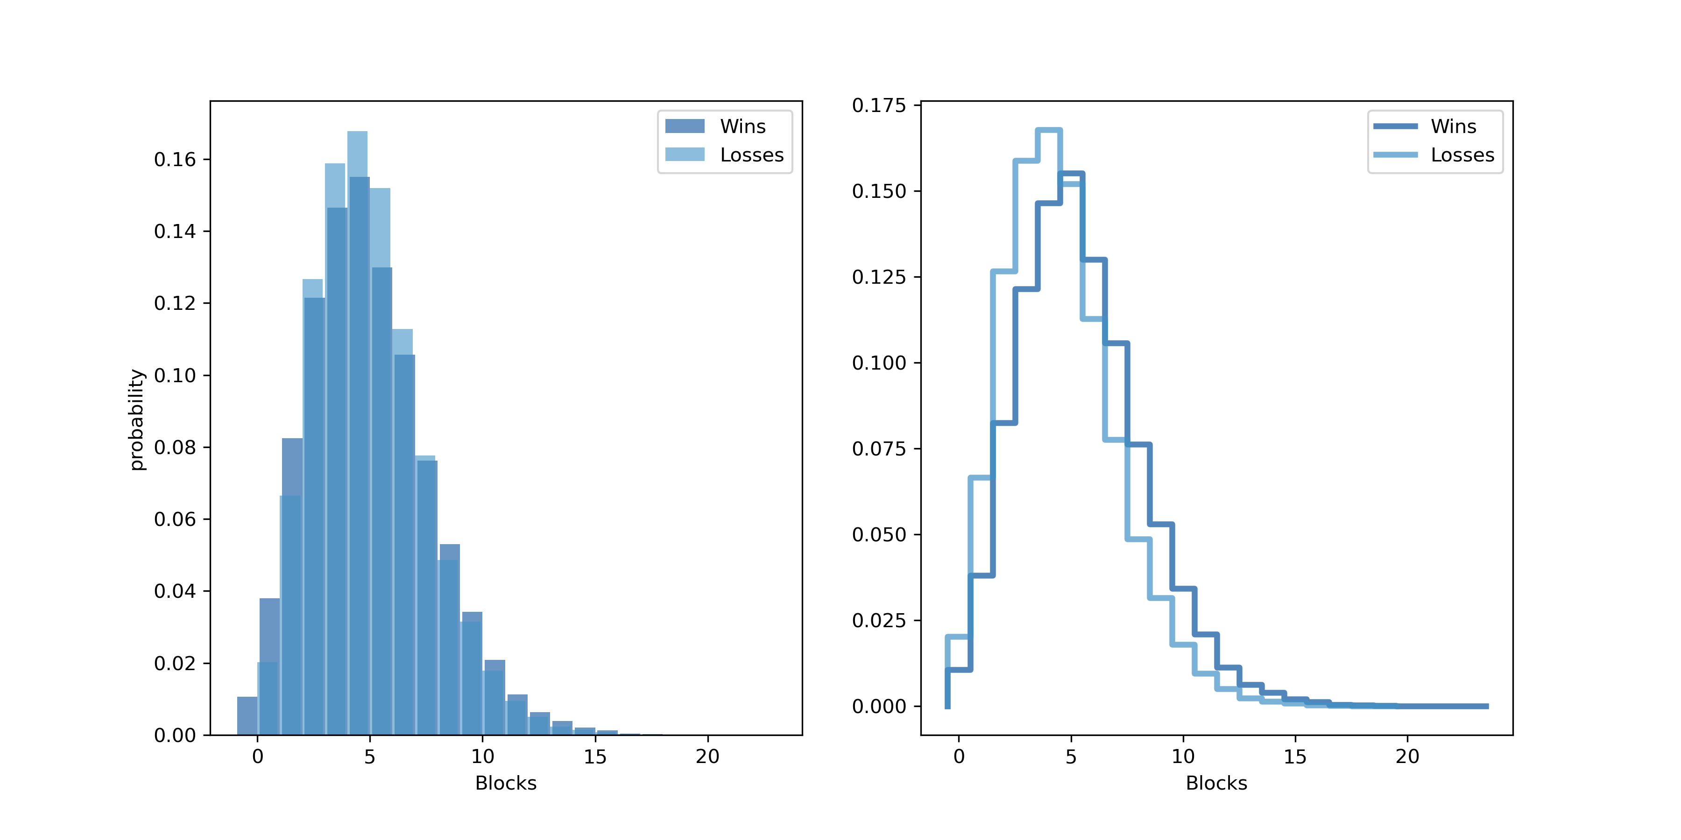
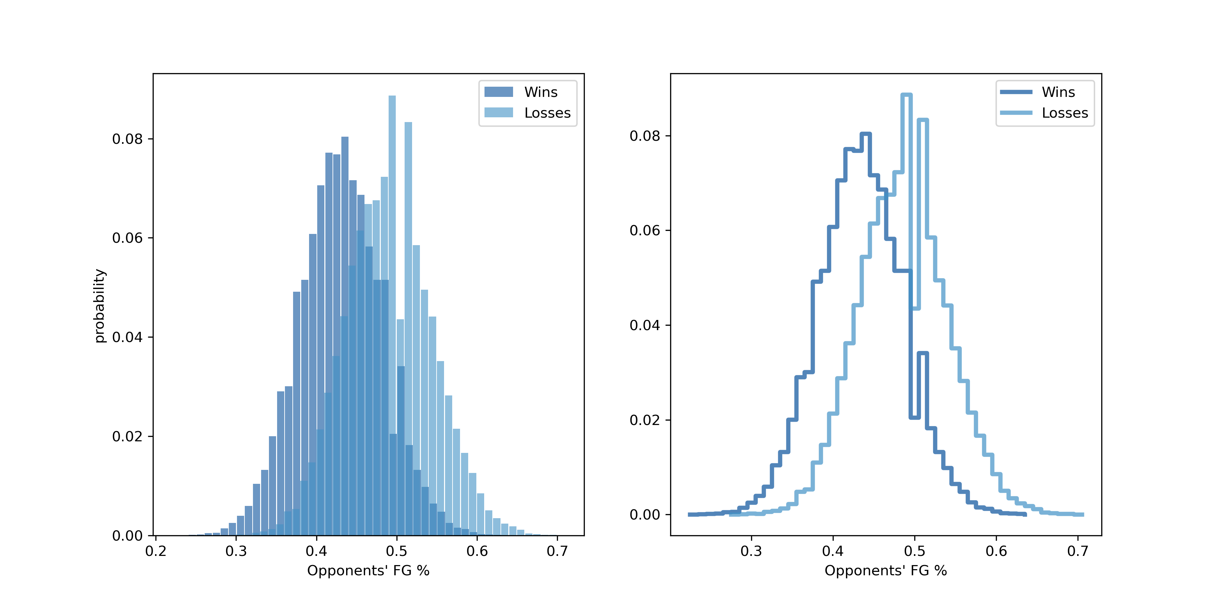
The PMF of Blocks is very similar
to the PMF of Steals.
The difference between Wins and Losses in the PMF
of FG % is the greatest. This implies that one of the
best things a team can do to increase their likelihood
of winning is to reduce their opponents’ field goal
percentage.
The team could either hope for the other team
to miss their shots or actually have an effect with
something that they can control which is to apply a
tougher defense to shooters and contest their shots.

Slide 17
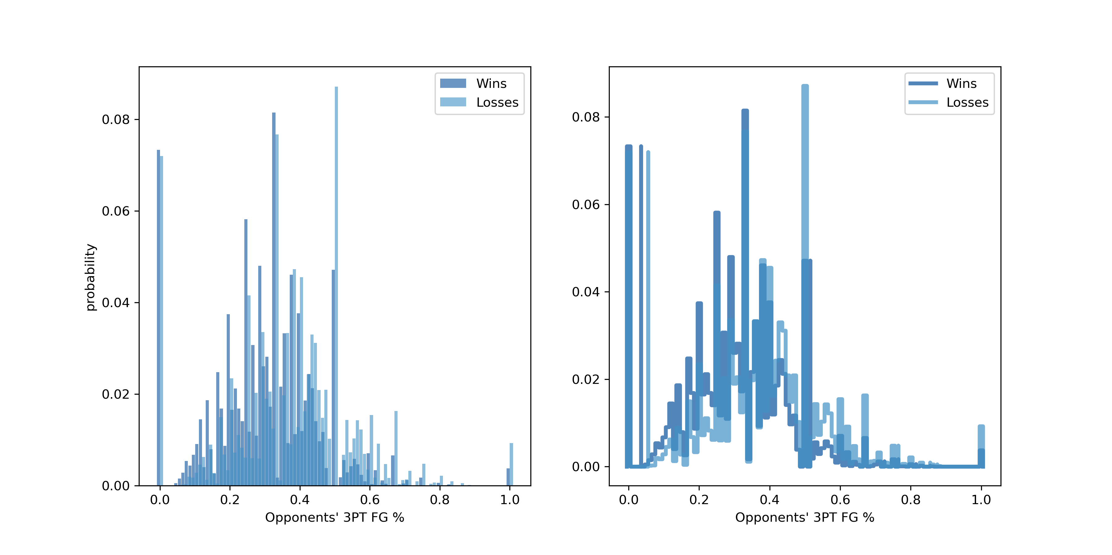
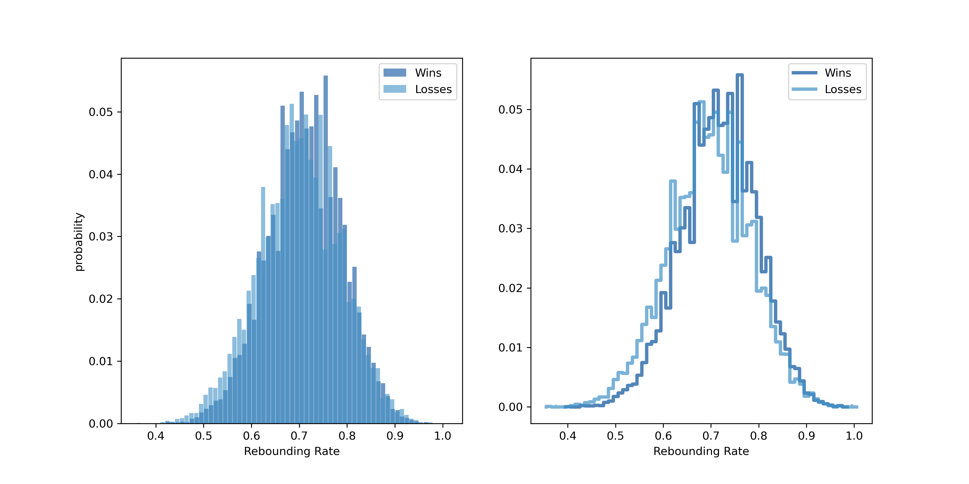
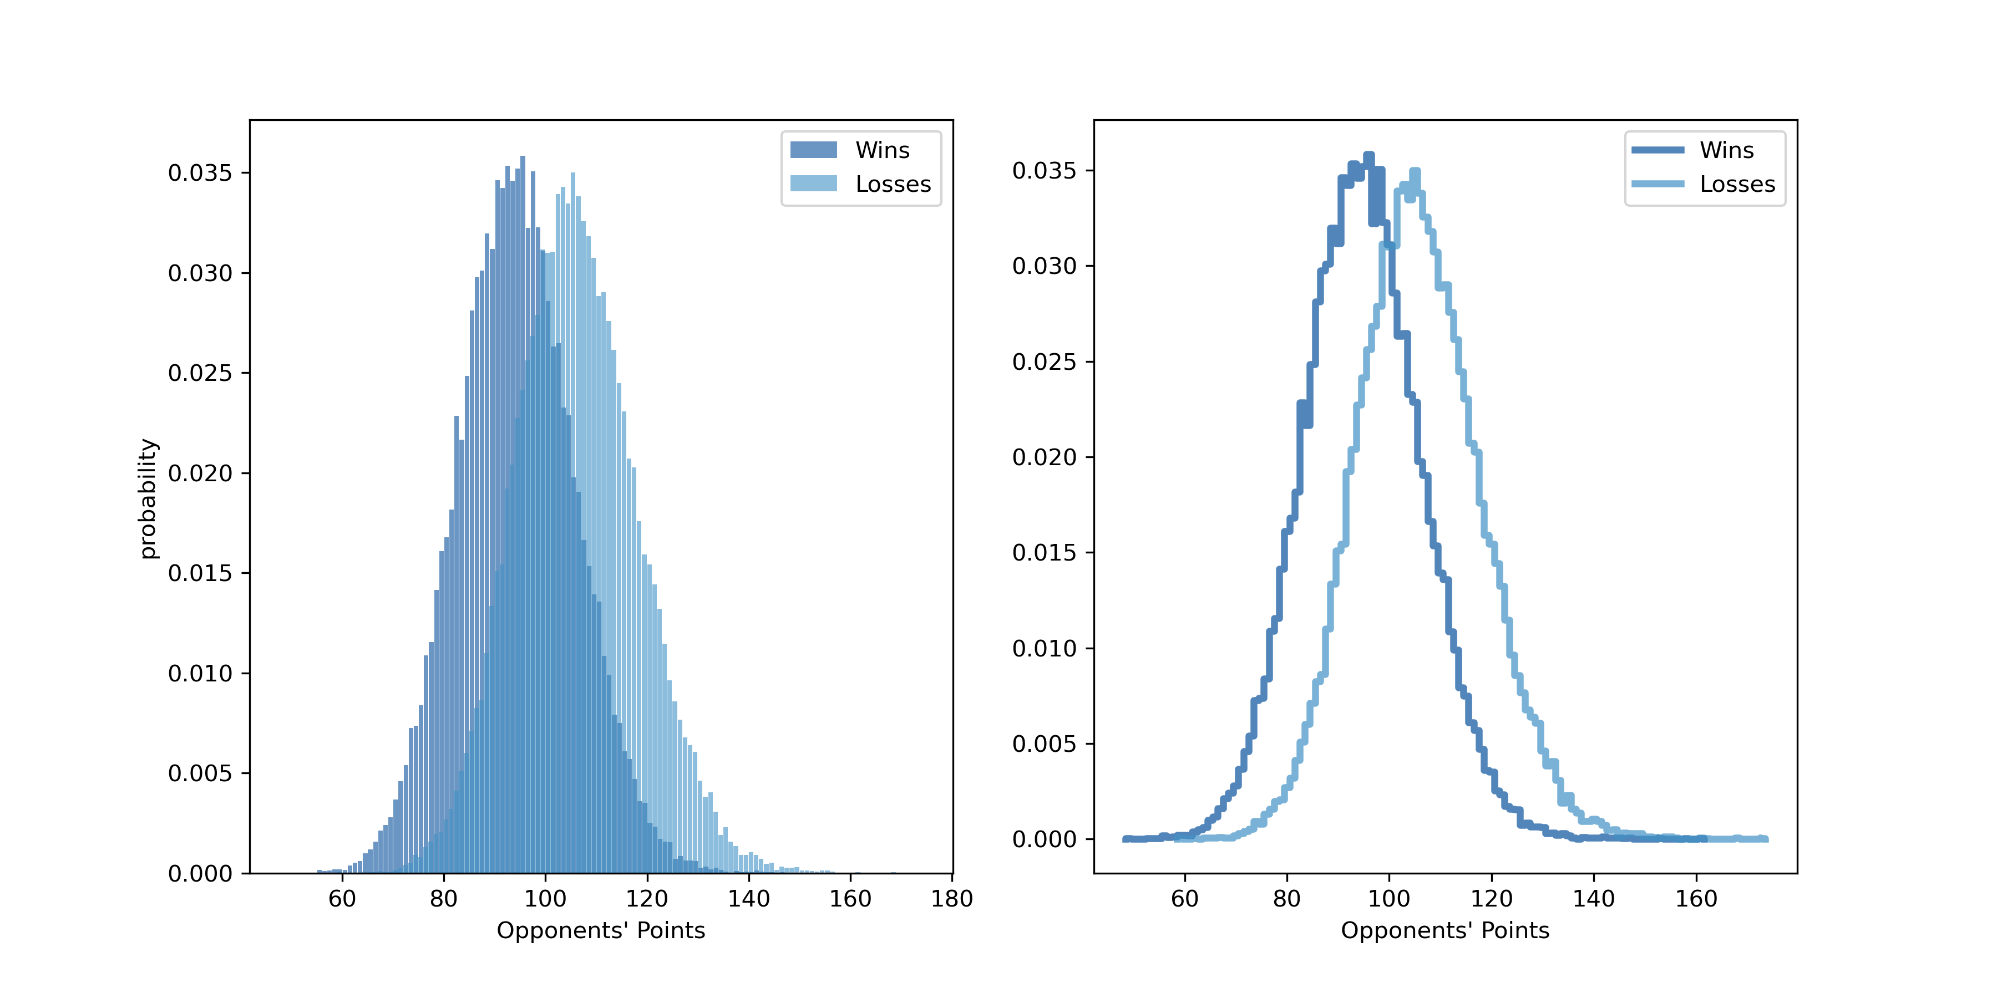
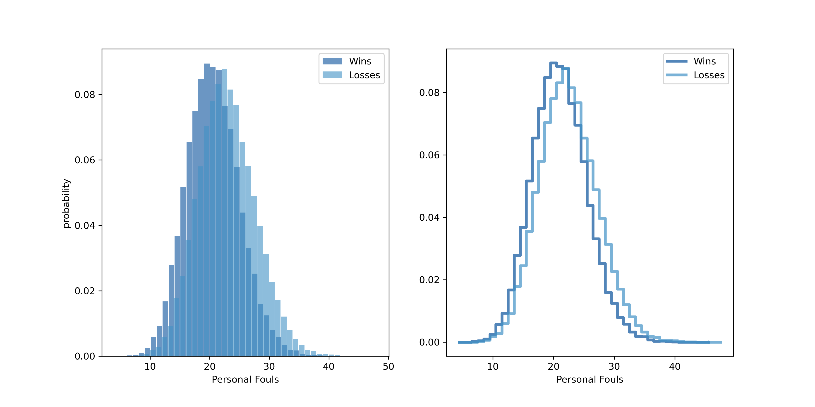
The PMF’s at the top [Opp’s 3FG%(left) & Reb. Rate(right)] are either too noisy or too difficult for me to interpret visually.
The PMF’s at the bottom either show too little difference [Fouls(right)] or are too basic [Opp’s Pts(left)] for me to find interesting.

Slide 18
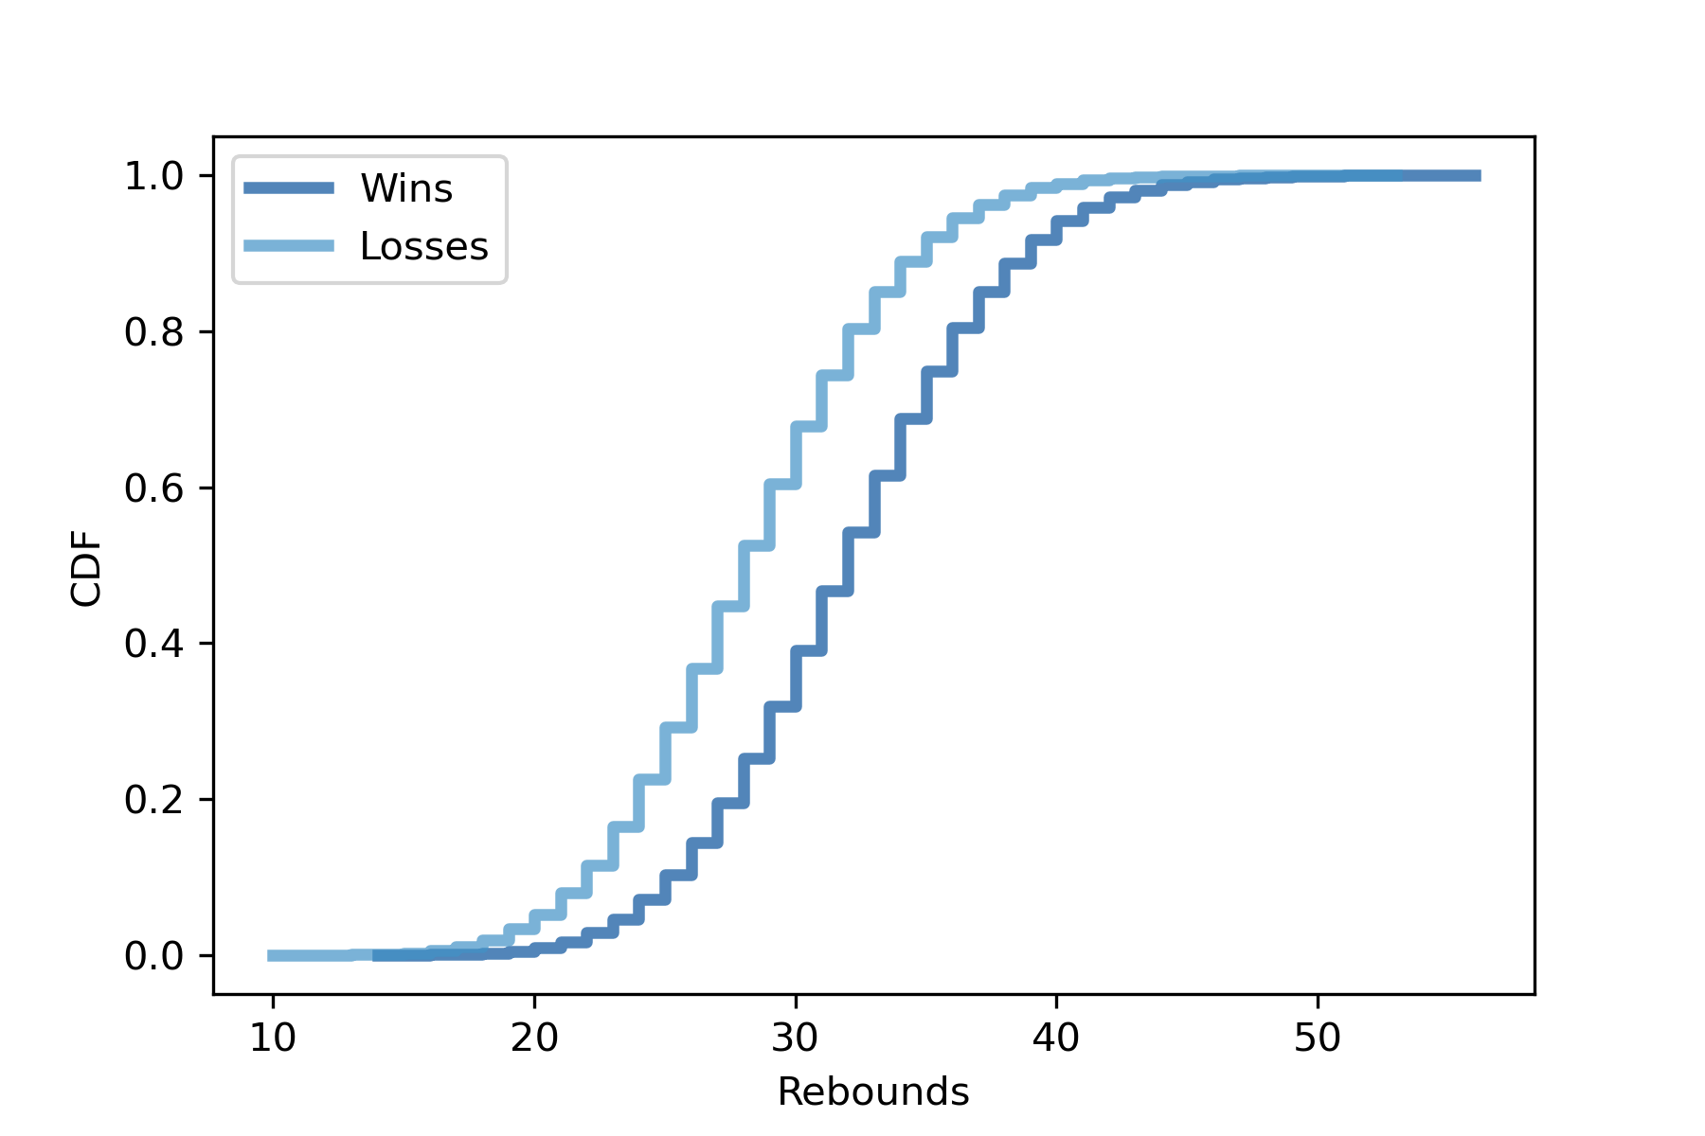
If we look at the middle 80%(between .1 and .9 on the y=axis) of games in this data set we see that the winning team always gets more rebounds – in this range the winning team gets about 3 more defensive rebounds
At the extremes this difference is less but still exists. It is also more difficult to see because the lines overlap.
The least amount of def. rebounds a winning team has ever gotten is 14. Even in the bottom 5% a winning team gets about 25 rebounds.
The least amount of def. rebounds ever was 10 but only in 10% of the games in this span does a team have less than 22 rebounds.
A total of 42 defensive rebounds would put a winning team in the 95th percentile and would place a losing team in the 98th percentile.
Anything over 48 defensive rebounds would put a team (win or loss) in the 99th percentile.
CDF of Rebounds for Wins vs. Losses
I was inclined to believe that maybe certain defensive stats would
be more impactful but based on the CDF’s of all the stats it looks
like rebounds are the biggest make-or-break stat.
Maybe this makes more sense if you think about the fact that if you
don’t rebound as much there are less opportunities to score and the other team has more. Also, rebounds are an indicator of missed shots by the opposing team.

Slide 19

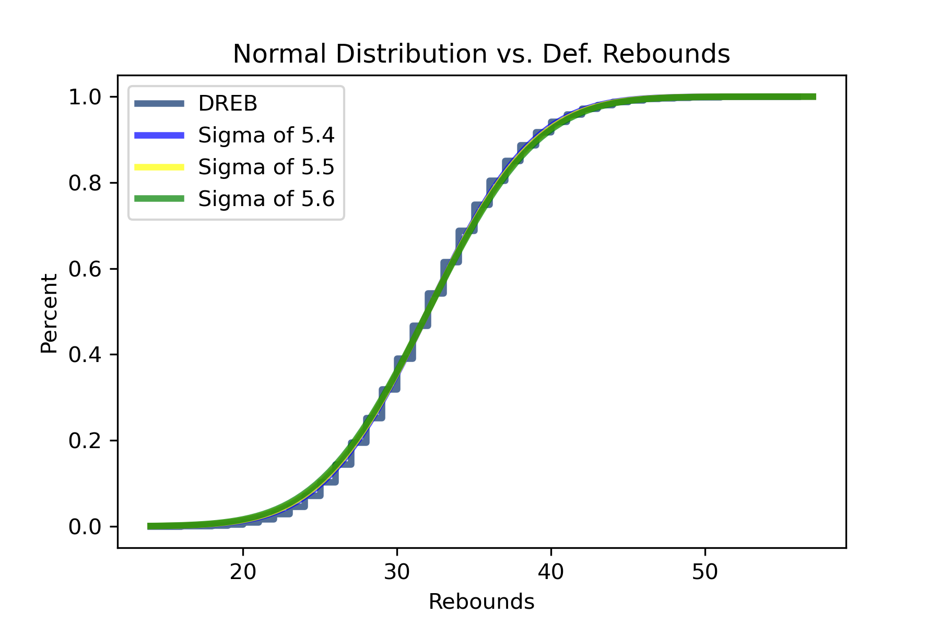
The normal distribution with a Mu of 32 and a Sigma of 5.5 is nearly a perfect model of the distribution.
However, in the lower end, like less than 25 is slightly overestimates.
This could be corrected by using a smaller sigma on the lower end.

Slide 20
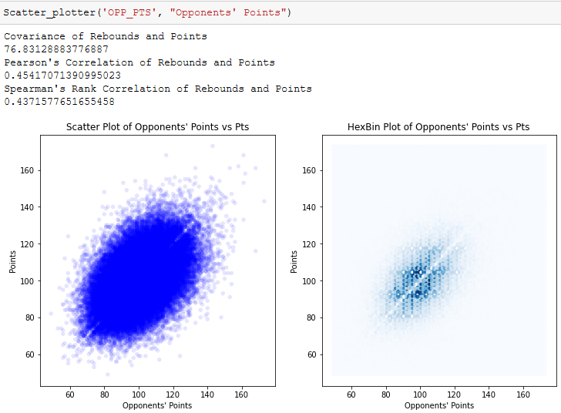
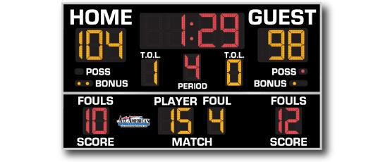

Positive covariance and relatively high Pearson’s and Spearman’s correlation scores correspond with the visualization. A higher correlation
would see the data less spread out. The sort of blankish line at slope=1
is an artifact of it being impossible for teams to score the same amount of points. (No ties/draws in basketball)
Difficult to make a deduction because
even at the extremes about half the
data is above and below so it is equally
likely to win or lose.
These results are not that intriguing or insightful and are moreso due to a thing
called pace.
Pace is how fast the game is played, how often are people scoring, and how quick possession is changing and is
not affected much by defense.

Slide 21
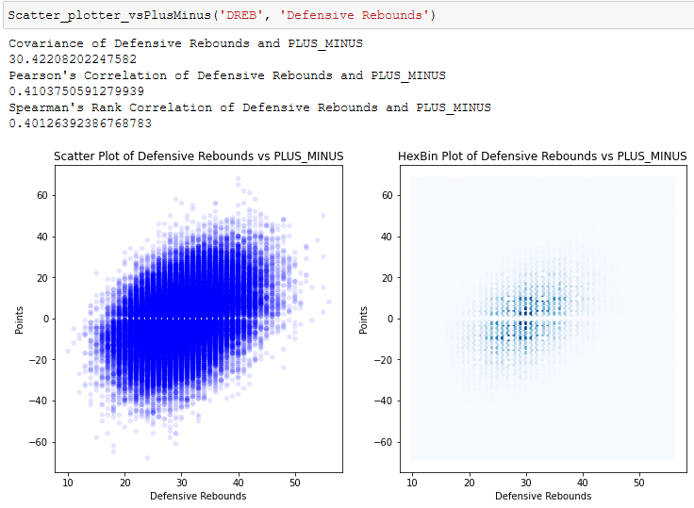
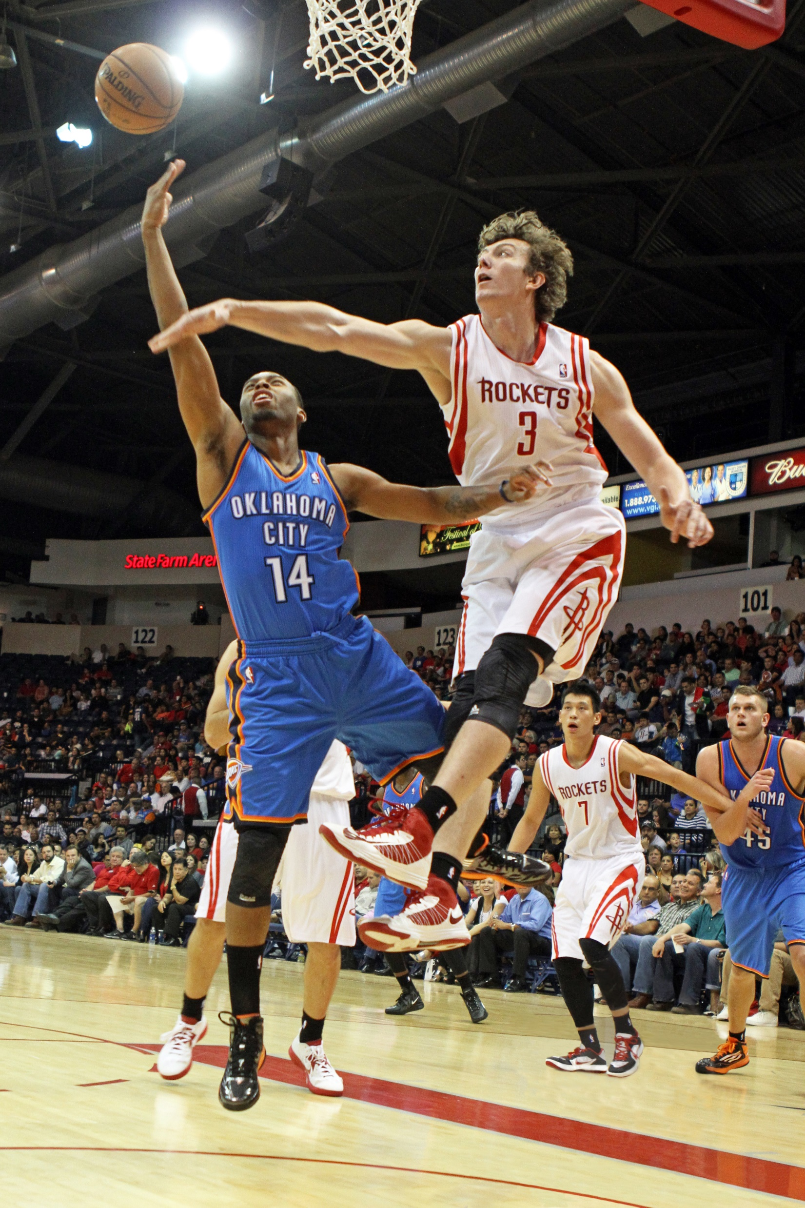
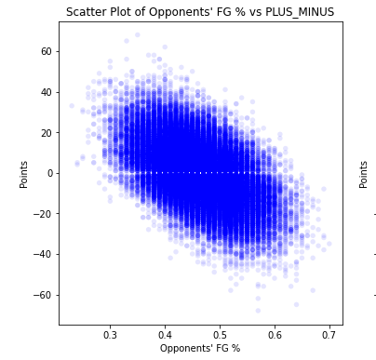
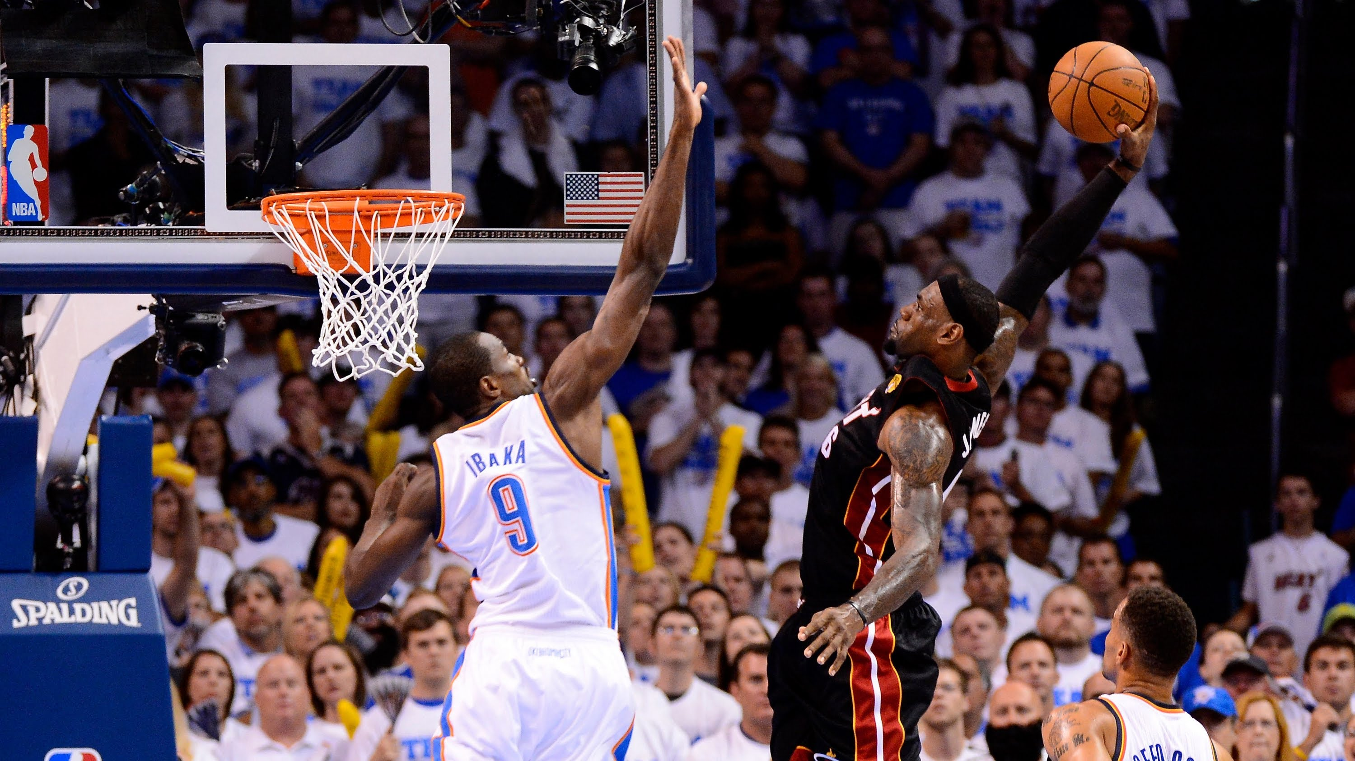
Was not able to calculate the
covariance and correlation but
regardless this is interesting
because of the negative covariance
and correlation apparent.
The closeness of Pearson
and Spearman scores
indicate that a linear
relationship explains most
of the covariance.
Rebounds had the 2nd highest correlation, both Pearson’s and Spearman’s, with the PLUS_MINUS statistic variable.
Covariance is more difficult to interpret unless it is apples to apples and tells us more about the direction of the relationship.
This Photo by Unknown Author is licensed under CC BY-SA-NC

Slide 22
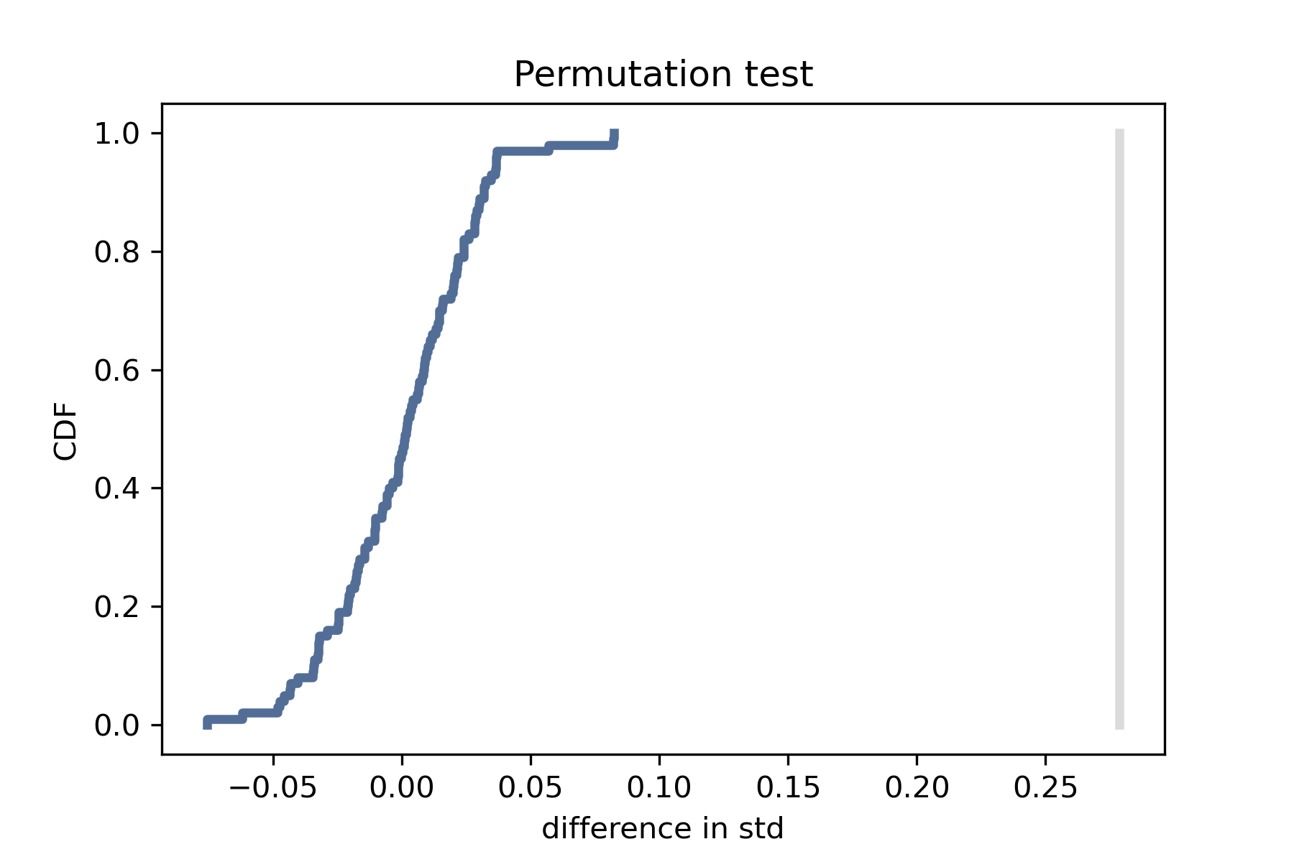
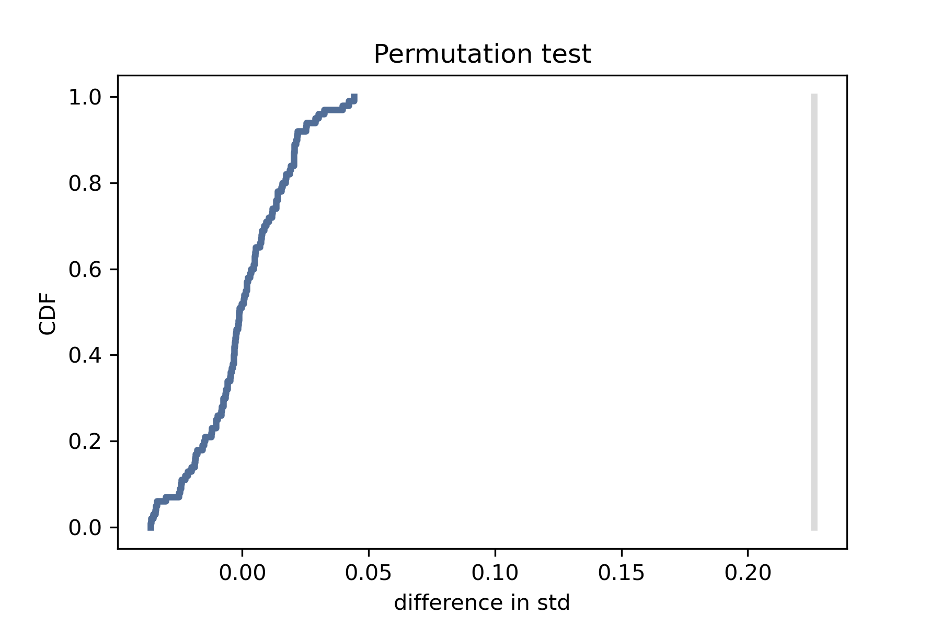
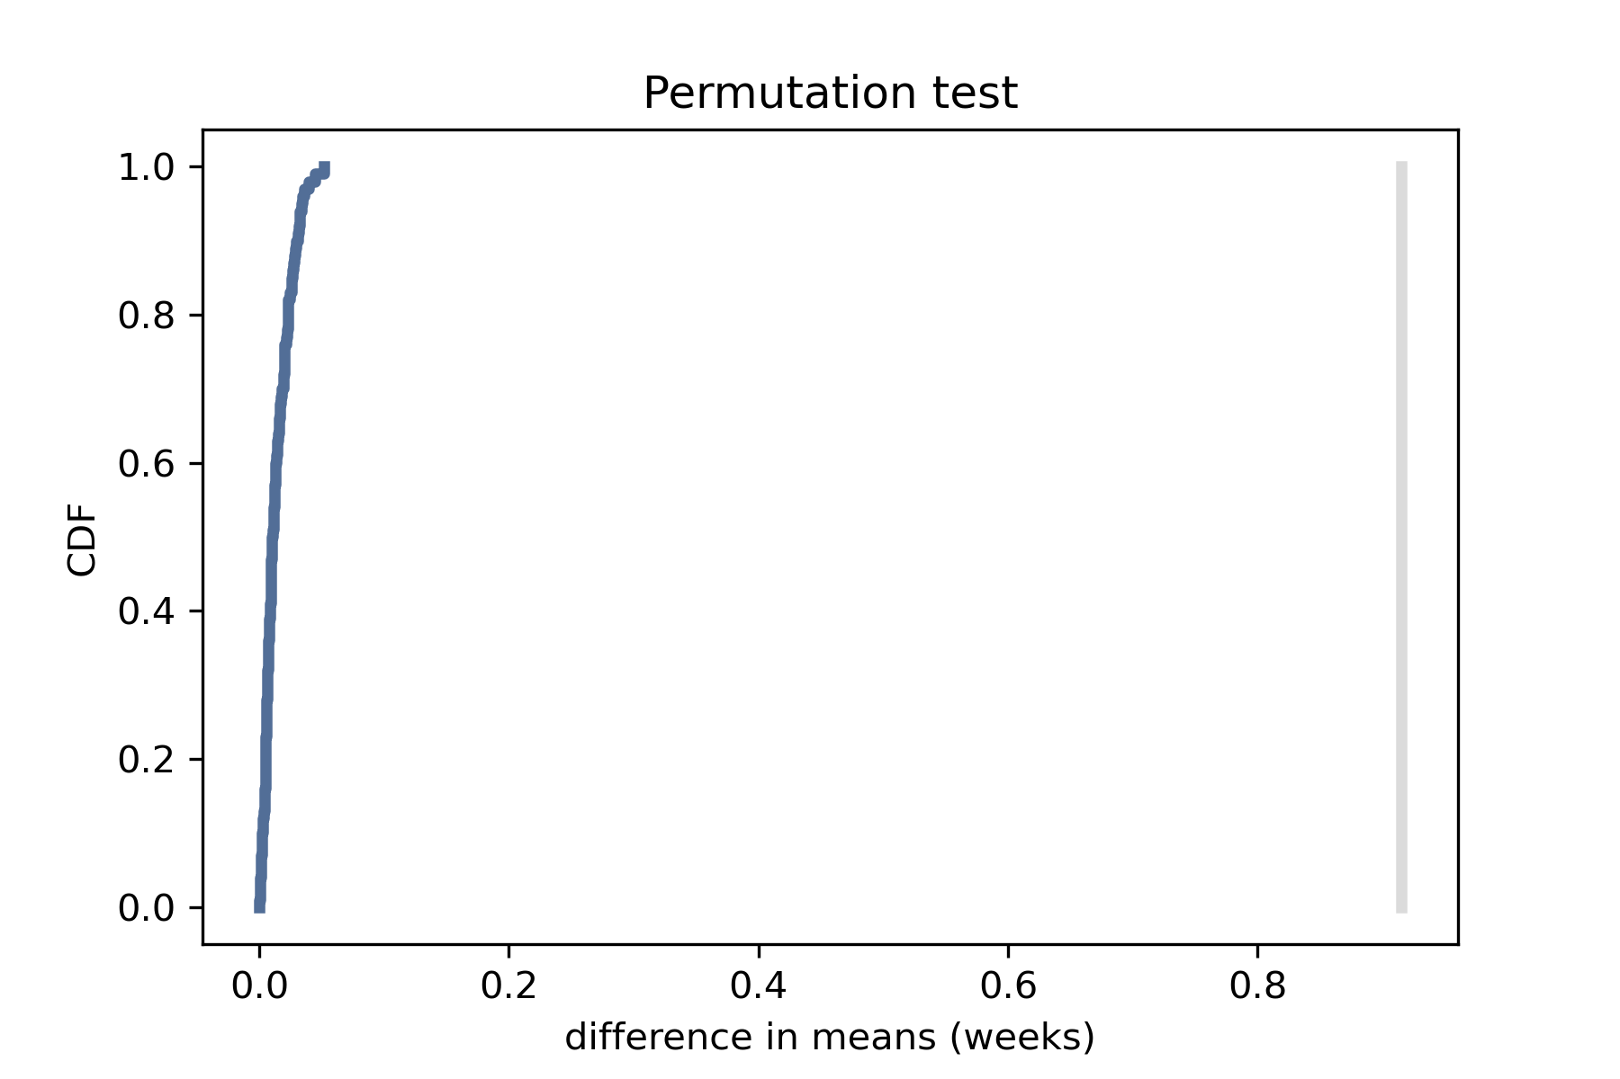
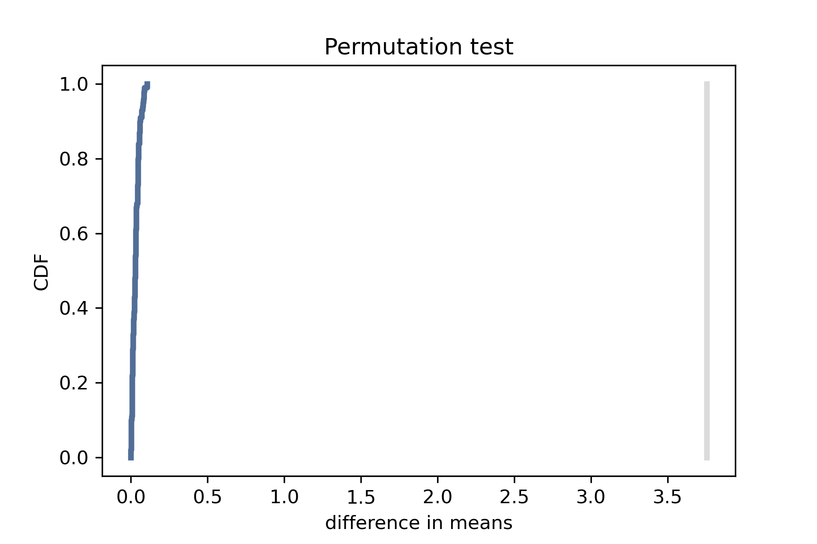
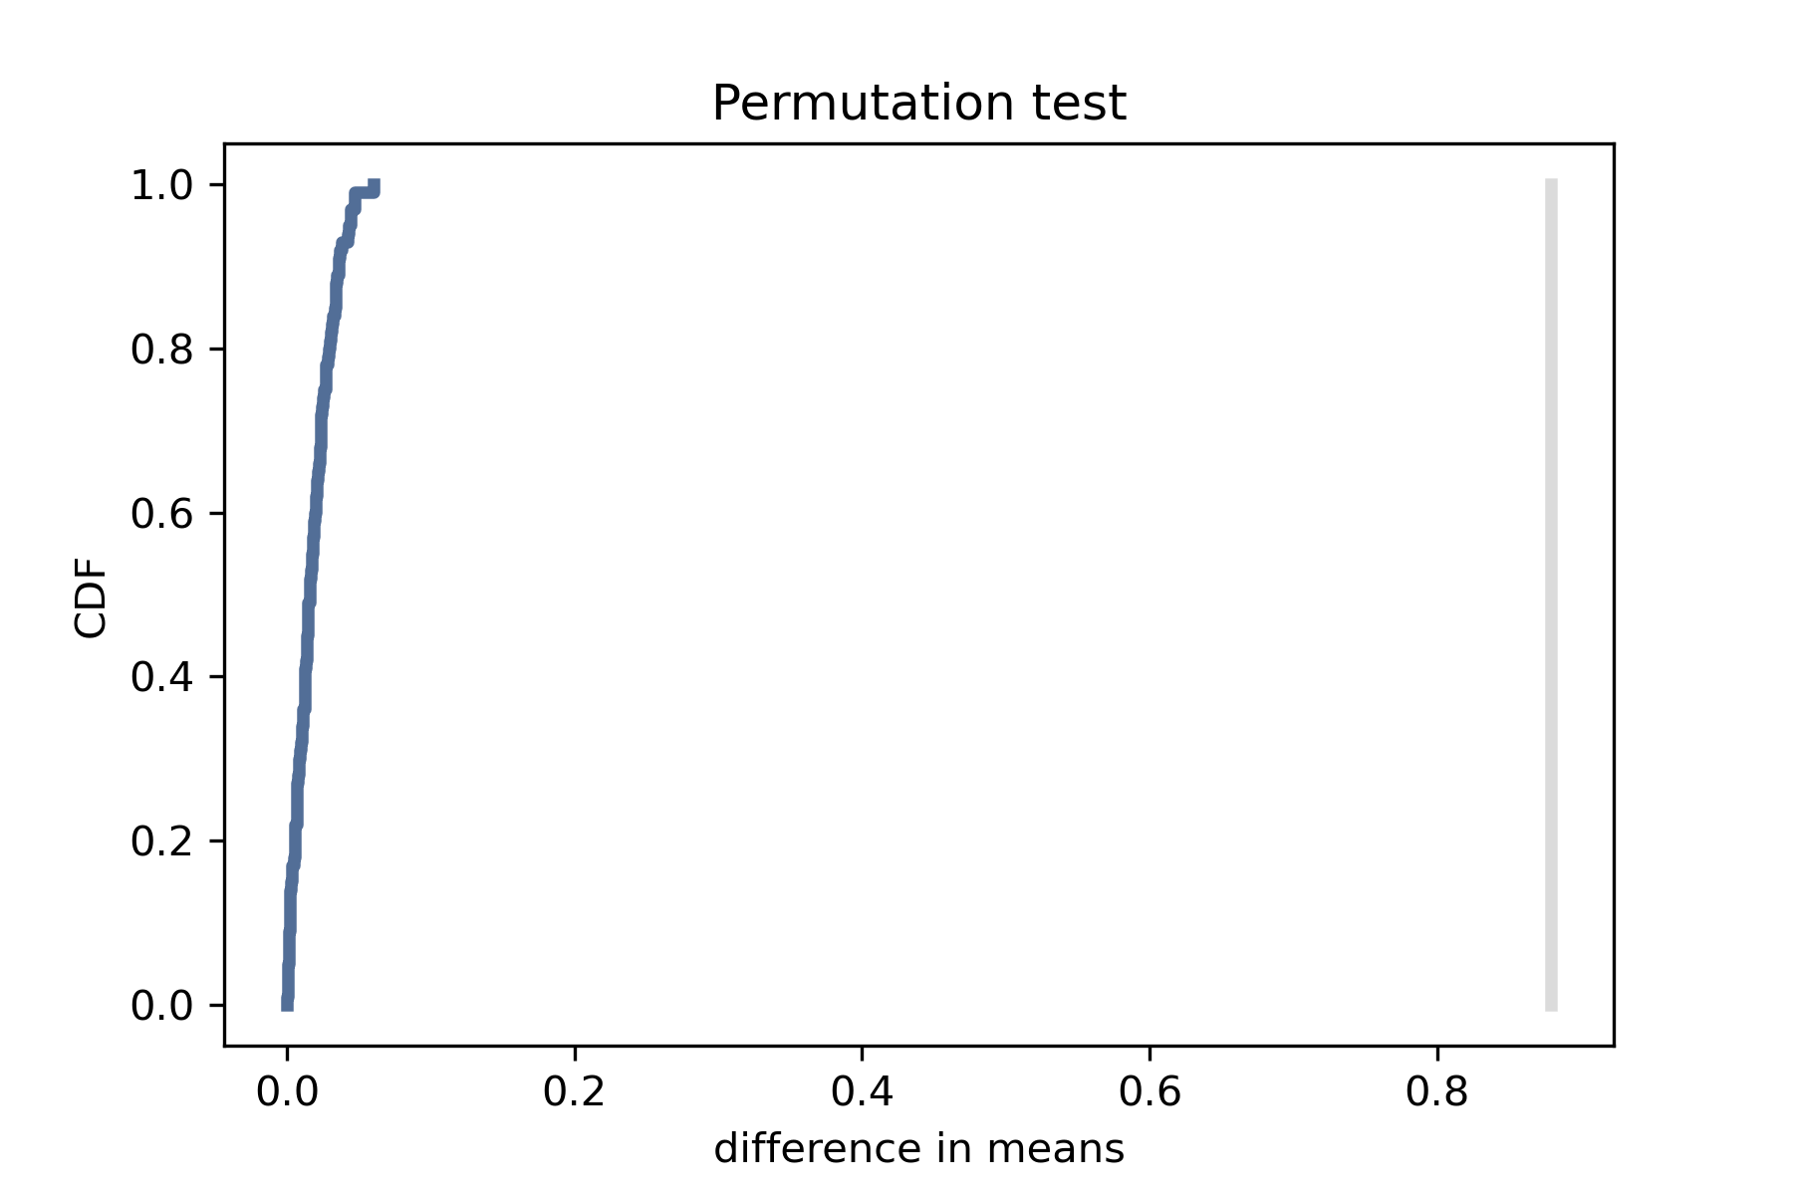
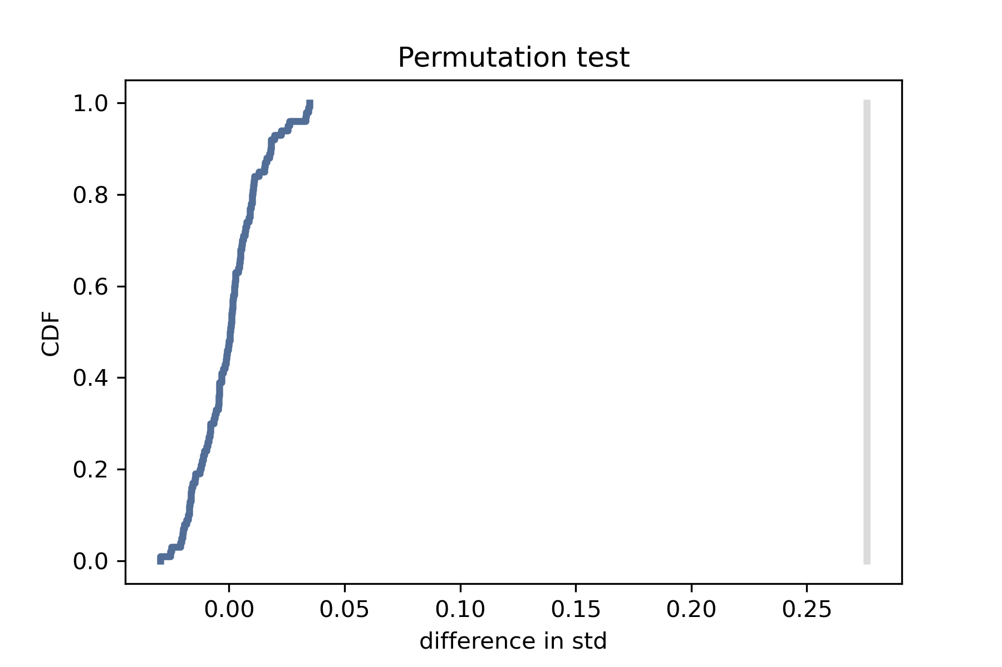
I had a hard time interpreting these.
None of my models ever crossed or even got near the actual differences.
The one that gets closest is rebounds with a test statistic of standard deviation.
Should I reject the null hypothesis in every one of these cases?
steals
rebounds
Hypothesis Testing
blocks
rebounds
steals
rebounds

Slide 23
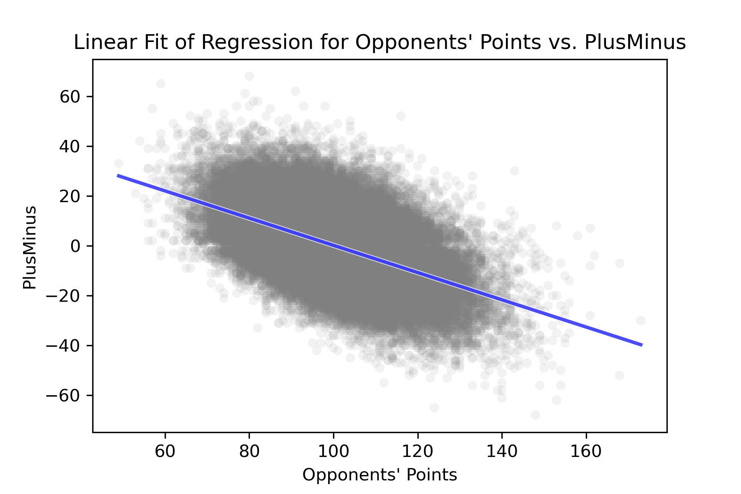
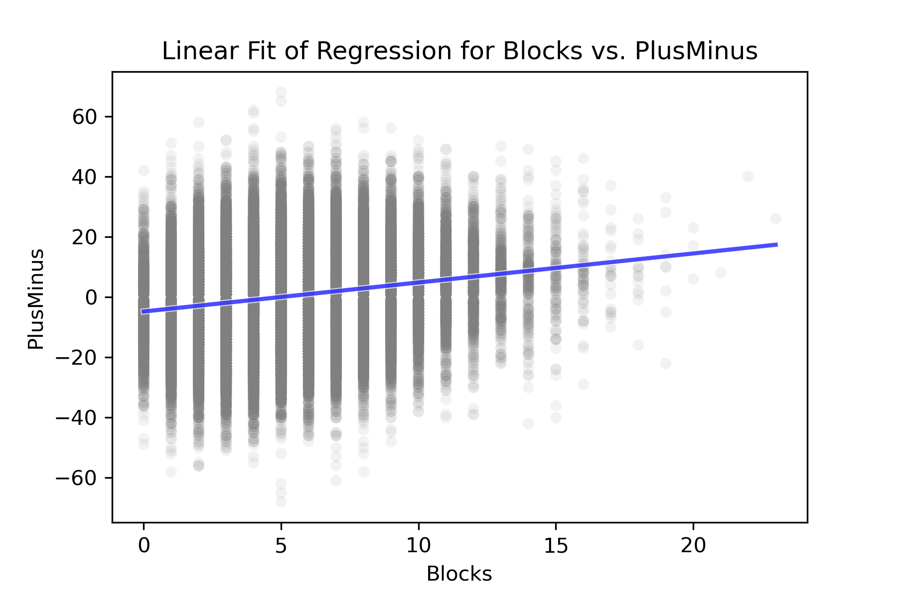
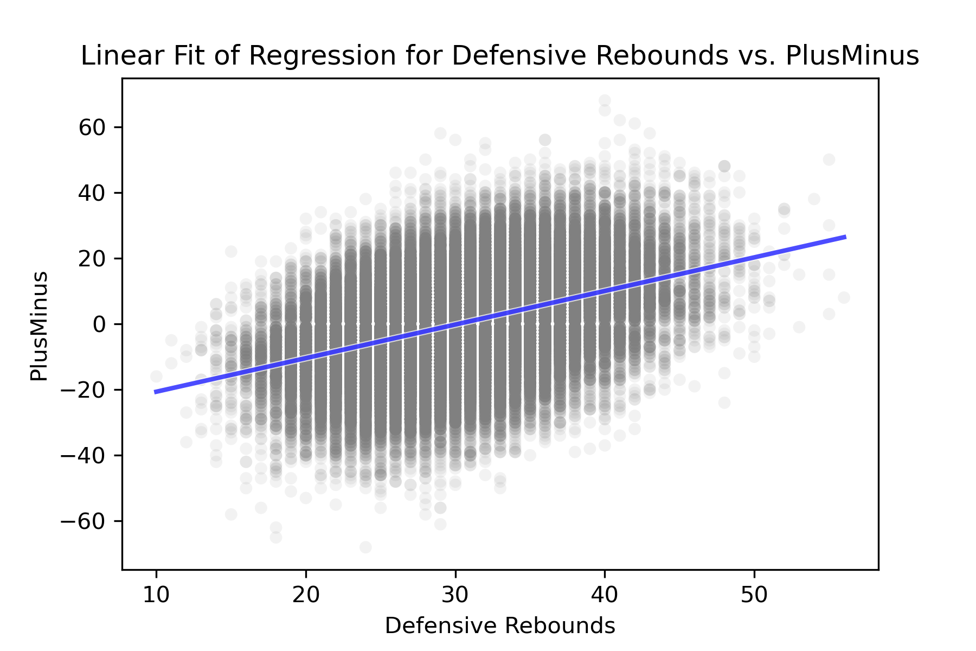
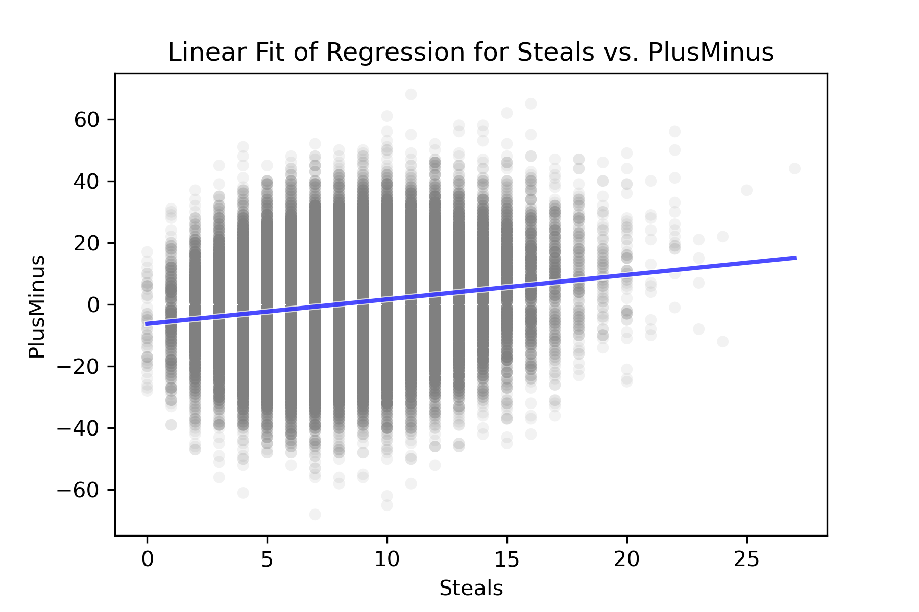

Slide 24
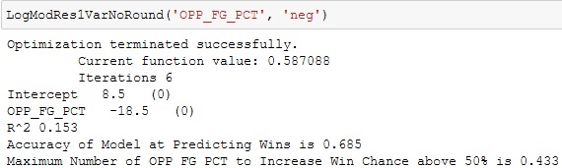
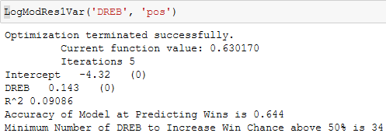
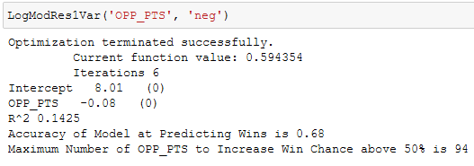
Several single variable logistic models
were run and calculated.
These are the highlights.
Notice that R^2 is not super high but
because these are logistic models the
R^2 are actually Pseudo-R^2 rather than
real R^2.
When intercept is positive the slope is negative
and vice versa.
The accuracy of all the models is similar
but the “R^2” is highest for Opponents’ Field
Goal percentage which makes it the best
single variable logistic model I was able to
find.
It is interesting to notice the solutions
which appear as the max. and min. values
to increase win probability. (Found using y=mx+b
,with y=.5, m=slope paramer, b= intercept)

Slide 25

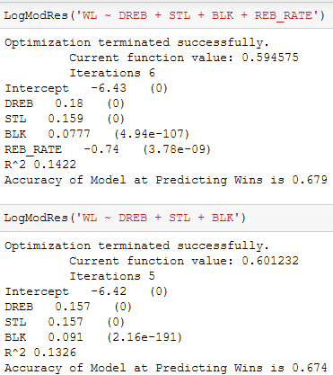
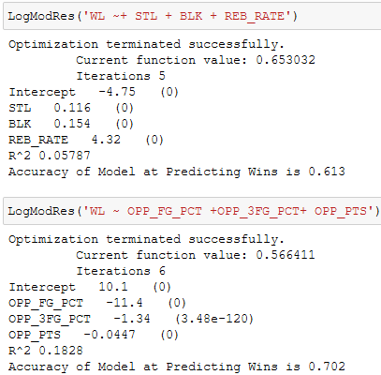
I used results from correlation and single regression to inform my choices here. The one on the bottom right is the best by
both accuracy and Pseudo-R^2. It uses Opponents’ FG% 3pt FG% and points. The model which use rebounds, steals, blocks,
and rebounding rate is not far behind.

Slide 26
In conclusion, I was surprised to find that rebounds were just as if not more impactful than other defensive statistics like steals and blocks in affecting a teams chance of ending up victorious.
The best ways to impact the outcome of the game based on my analysis is to reduce the opponents’ points which can be done through various means.
One such way is to reduce an opponents’ field goal percentage through increasing the pressure on shooters by covering them more tightly.
Rebounding rate was impactful but can only be altered by not allowing the other team to get the offensive rebound which is a quintessential fundamental of defense.
Although steals and blocks do make a difference the results of my analysis lead me to believe that emphasis should be placed on rebounding. Field goal percentage does have an affect but 3-point field goal percentage is somewhat random and so not too much extra priority should not be given to guarding three pointers over regular shots.

